Slide 1
Topical Review 2
Hypothesis Testing, Bootstrap, A/B Testing, and Confidence Intervals

Slide 2
Hypothesis Testing Basics

Slide 3
Hypothesis Testing: Terms to Know
Null hypothesis - a claim about the world--a specified chance model
Alternative hypothesis - there is some reason (other than chance) why the data in the observed sample differ from the null hypothesis
This comes from the set up of the question! Read carefully to see whether we care about the direction or not.
Test statistic - a statistic used to evaluate samples, e.g. TVD or average. This takes a sample and represents it in a single number.
Indicator of whether a sample is consistent with the Null or not (Alternative).

Slide 4
Hypothesis Testing: Terms to Know
Observed test statistic - value of the test statistic for an observed sample
P-value - likelihood that the test statistic generated under your null hypothesis is equal to or further in the direction of the alternative than your observed test statistic

Slide 5
Null & Alternative
Null hypothesis should be very clearly defined
should be able to simulate a sample just from the null hypothesis
For example: “the coin is fair” tells us 50% chance heads and 50% tails
Now I can simulate using sample_proportions
Alternative hypothesis is based on context
For example: “the coin is not fair” or “the coin is biased towards heads” are both valid alternative hypotheses. You need to see what the question is trying to test to choose the correct alternative hypothesis

Slide 6
Test Statistic
Values of your test statistic under the null should be different than values of the test statistic under the alternative
Choose a test statistic according to the directionality of your alternative hypothesis
Categorical data with 2+ categories--consider TVD
measures how different 2 distributions are
If your alternative hypothesis is that something is different (rather than larger/smaller)--consider using absolute value to remove directionality.

Slide 7
Visual Example
Null: The coin is fair
Alt: The coin is unfair
Pick a test statistic based on 10 coin flips
Possible # heads in 10 coin flips
0 1 2 3 4 5 6 7 8 9 10
See how there are 2 locations on the number line if coin was unfair? It looks like we have 3 areas but we want to differentiate between 2 hypotheses
Abs Value of # heads - 5
0 1 2 3 4 5
If coin was unfair If coin was fair If coin was unfair
If coin was fair If coin was unfair
Notes:
The more extreme our test statistic, the more it should point toward the null or alternative

Slide 8
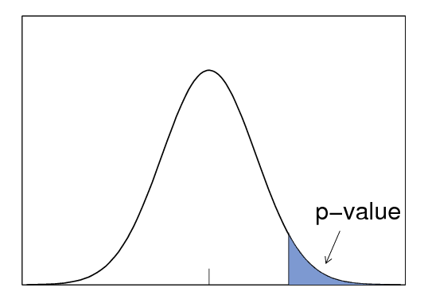
P-value
Distribution of data simulated assuming null is true
The chance of seeing a test statistic equal to or further in the direction of our alternative hypothesis than our observed statistic, assuming the null were true.
In other words, the proportion of simulated data (assuming the null is true) that has a test statistic equal or more extreme than the observed statistic.
Observed value of the test statistic

Slide 9
P-Value Code
P-Value = Chance, under the null, that the test statistic is
equal to the observed value or further in the direction of the alternative
these values were created under the null observed value of test statistic
# times a test statistic is the observed value or further total # of test statistics simulated under the null
further in the direction of the alternative
equal to
p_value = np.count_nonzero(all_test_stats >= 20) / 1000

Slide 10
P-Value Interpretation
P-value cutoff (or significance level) chosen before testing
P-value cutoff - how strong you require the evidence against the null hypothesis to be before rejecting it (often is 0.01 or 0.05).
P-Value is small → seeing observed value is highly unlikely assuming
the null is true
→ but we saw the observed value in real world...
→ data is not consistent with the null
P-Value < cutoff, then reject the null
P-Value > cutoff, then fail to reject the null

Slide 11
Practice: Adeel Loses
Adeel loves playing at the casino. His favorite game is craps, a dice rolling game. One day, he doesn’t do very well (only getting 7 sixes in 100 rolls of the die), and he suspects the house has been using loaded dice! In other words, he thinks the casino’s dice are less likely to roll a 6 than normal dice.
What should his null hypothesis be?
What should his alternative hypothesis be?
What test statistic should he use?
What's the observed value of the test statistic?
What size of values of the test statistic do you expect if the alternative is true?

Slide 12
Practice: Adeel Loses
What should his null hypothesis be? Each roll is a 6 with probability ⅙, and any deviation in his sample is due to chance.
What should his alternative hypothesis be? Each roll is a 6 with probability less than ⅙.
What test statistic should he use? Proportion of 6s in 100 rolls.
What is the observed value? 7/100
What size of values of the test statistic do you expect if the alternative is true? small!

Slide 13
Practice: Adeel Loses
Simulate Adeel's test statistic 10000 times and compute the p-value
fair_die = make_array(⅙,⅙,⅙,⅙,⅙,⅙)
proportions = make_array()
for i in np.arange(10000): proportion = sample_proportions(100, fair_die).item(5) proportions = np.append(proportions, proportion)
p_value = np.count_nonzero(proportions <= 7/100) / 10000
(observed test statistic is 7/100)

Slide 14
Practice: Delivery Wait Times
SuperEats promises food delivery times of 25 minutes. The fine print says that SuperEats only promises that each customer's delivery time is a random sample from a normal distribution with a mean of 25 minutes and a standard deviation of 8 minutes.
Annie makes an order on SuperEats but finds the delivery time to be a lot longer than advertised. She decides to conduct a hypothesis test to determine if the mean delivery time is more or less than 25 minutes. To conduct the test, she orders 30 items from SuperEats and measures how long each delivery takes.
What is the null hypothesis? The alternative hypothesis?
What are some examples of valid and invalid test statistics?

Slide 15
Practice: Delivery Wait Times
What is the null hypothesis? The alternative hypothesis? A valid and invalid test statistic?
Null: The average delivery time is 25 minutes.
Alt: The average delivery time is not 25 minutes.
Test Stats
Valid: Absolute difference between the mean delivery time of the 30 deliveries and the advertised delivery time (25 minutes).
Invalid: Mean of the 30 delivery times

Slide 16
Practice: Delivery Wait Times
Annie placed the 30 orders and calculated the total wait time to be 870 min.
Given a histogram of simulated test statistics, how would you find the p-value? What bins for the histogram would work to find the exact p-value? Assume there are no delivery times past 100
Solution:
The observed test stat = abs(870/30 - 25) = abs(29-25) = 4
Find the total area of the bins that are equal to or larger than 4.
Bins array must include 4 and go to a reasonable end like 101
ex. np.arange(0, 101, 4) ← step size can be 1, 2 or 4

Slide 17
Practice: Delivery Wait Times
If the null hypothesis is true, what is the chance that Annie still rejects if she chooses a significance level of 0.05?
Solution:
There's a chance under the null of getting test statistics greater than the observed value, which may lead us to believe the alternative. If we use a p% cutoff and the null is true, there's a p% chance we will incorrectly reject the null.

Slide 18
Practice: Delivery Wait Times
If we use a p% cutoff and the null is true, there's a p% chance the test will still reject the null. Why do medical scenarios usually use a smaller p-value cutoff?
Solution:
If the null is true, e.g. if a drug has no effect, the test will conclude that the drug does have an effect p% of the time. This could lead to the prescription of a drug with potentially dangerous side effects that doesn’t actually treat the condition in question. By reducing the p-value cutoff, drug developers reduce the likelihood that an ineffectual drug makes its way to market.

Slide 19
The Bootstrap and CIs

Slide 20
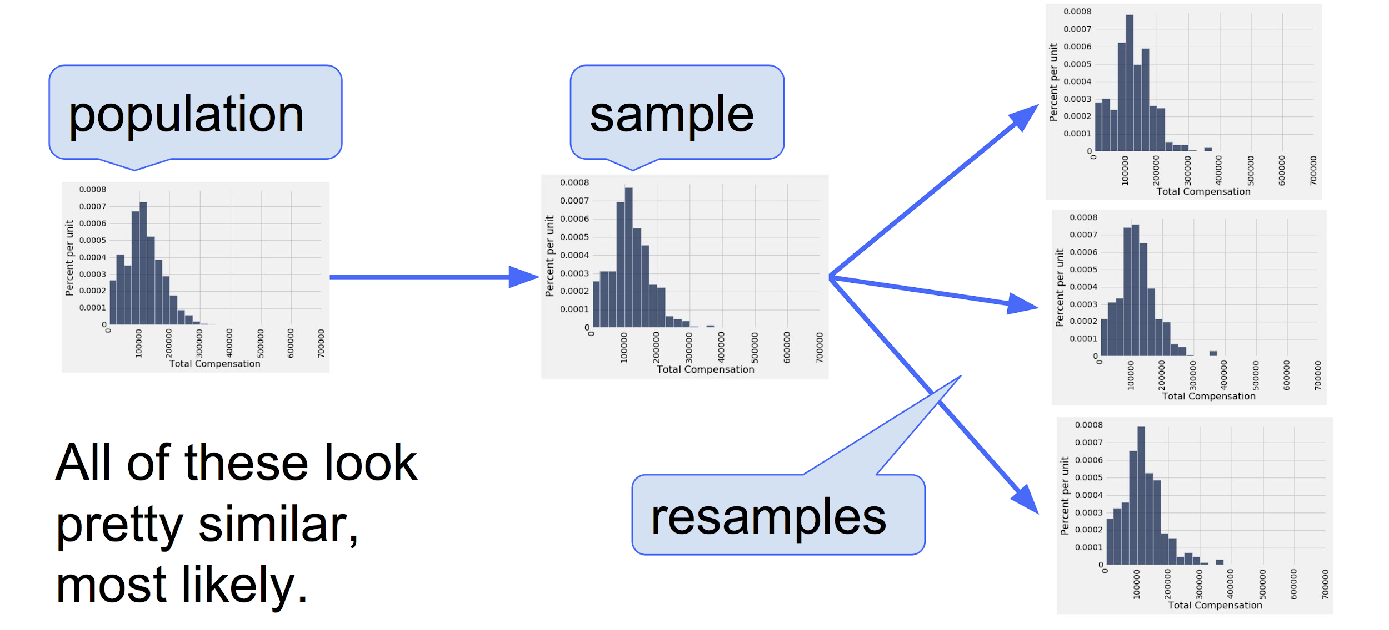
Bootstrap
We take a sample to get an estimate for a population parameter (e.g. the mean)
We’d like to get an idea of how much our estimate would change if we got a different sample from the population. (But we can’t get another sample a lot of the time!)
Bootstrap: We treat our collected sample as the population, and resample with replacement the same size as the original sample.
bootstrap_sample = tbl.sample()

Slide 21
Bootstrap
Steps:
Treat our sample as the data we have access to
Draw with replacement with the same size as the original sample
This allows each sample to have a different calculated test statistic
Each sample size is the same to keep the variance the same
Take the middle 95% of the range of bootstrapped values to create a CI
Uses:
When you only have access limited amount of data
Helps create CIs to estimate a parameter, and can be used to run hypothesis tests

Slide 22
Similarity between HT and Bootstrap CI
def hypothesis_test(observed, statistic):
stats = make_array()
for i in np.arange(10000):
sample = <sample from null dist>
sample_stat = statistic(sample)
stats = np.append(stats, sample_stat)
return np.mean(stats >= statistic(observed))
*Note: This function assumes a right-sided alternative hypothesis. Computation of p-value may be different for other alternate hypotheses.
def bootstrap(observed, statistic):
stats = make_array()
for i in np.arange(10000):
sample = <resample from observed>
sample_stat = statistic(sample)
stats = np.append(stats, sample_stat)
lower = percentile(2.5, stats)
upper = percentile(97.5, stats)
return make_array(lower, upper)
Important Note: Code for confidence intervals and code for hypothesis testing are very similar.

Slide 23
Bootstrap Code
Define a function called bootstrap that will bootstrap from a sample 10,000 times using the mean as the test statistic. Assume that column 0 is the column with the data we care about.
def bootstrap(tbl):
statistics = make_array()
for __________________:
bootstrap_tbl = _____________________
statistic = ________________________
statistics = ________________________
return statistics

Slide 24
Bootstrap Code (Solution)
def bootstrap(tbl):
statistics = make_array()
for i in np.arange(10000):
bootstrap_tbl = tbl.sample()
statistic = np.mean(bootstrap_tbl.column(0))
statistics = np.append(statistics, statistic)
return statistics
*Note: tbl.sample() by default draws tbl.num_rows samples with replacement. tbl.sample(tbl.num_rows, with_replacement=True) would work as well.

Slide 25
Confidence Intervals

Slide 26
95% Confidence Intervals
Interval of estimates of a parameter
Based on random sampling
95% is called the confidence level
Could be any percent between 0 and 100
Higher level means wider intervals
The confidence is in the process that gives the interval:
It generates a “good” interval about 95% of the time i.e. one that contains the true population parameter

Slide 27
Is This What a CI Means?
An approximate 95% confidence interval for the average age of the mothers in the population is (26.9, 27.6) years.
True or False:
There is a 0.95 probability that the average age of mothers in the population is in the range 26.9 to 27.6 years.
Answer: False. The average age of the mothers in the population is unknown but it’s a constant. It’s not random. No chances involved.

Slide 28
Using CI for Hypothesis Test
Null hypothesis: Population average = x
Alternative hypothesis: Population average ≠ x
Cutoff for P-value: p%
Method:
Construct a (100-p)% confidence interval for the population average
If x is not in the interval, reject the null
If x is in the interval, can’t reject the null

Slide 29
CI Question
Hari goes to his favorite restaurant and feels that it’s not quite as good as he remembers. He goes on Yelp to find people who have reviewed the restaurant before the last time he ate there. He tracks down 100 of these people and asks them for their current rating of the restaurant so he can compare and see if the rating has dropped. To determine whether it has, he takes the difference between the old rating and the new rating (old rating - new rating).
Let rating_differences be an array of the differences in the ratings of all the people you surveyed. How can a confidence interval help Hari determine whether or not the restaurant’s quality has degraded?
Suppose Hari’s 95% confidence interval for the true mean rating drop is [0.135, 1.241]. Do you fail to reject or reject the null hypothesis with a p-value cutoff of 5%? How about 10%? 1%?

Slide 30
CI Question Answer
Let rating_differences be an array of the differences in the ratings of all the people you surveyed. How can a confidence interval help Hari determine whether or not the restaurant’s quality has degraded?
You can compute a (100 - p)% confidence interval for the true average of the drops in rating. If the interval does not contain 0, then you can reject the null hypothesis with a significance level (p-value cutoff) of p%.

Slide 31
CI Question Answer
2. Suppose Hari’s 95% confidence interval for the true mean rating drop is [0.135, 1.241]. Do you fail to reject or reject the null hypothesis with a p-value cutoff of 5%? 10%? 1%?
5%: reject; 0 not contained in 95% CI
10%: reject; 0 not contained in 90% CI, since this is narrower than the 95% CI
1%: don’t know; 99% CI is wider than 95% CI. It could contain 0

Slide 32
Central Limit Theorem

Slide 33
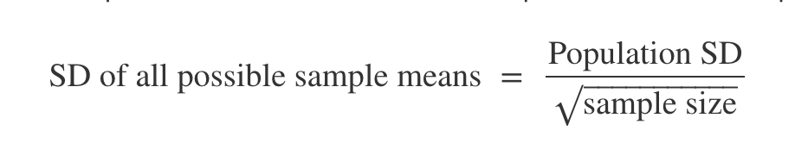
Central Limit Theorem
Law of Averages: As sample size increases, sample mean gets closer to population mean
Central Limit Theorem: Distribution of sample means/sums is approximately normal regardless of shape of population distribution
Mean of dist = population mean

Slide 34
Why is CLT useful for CI?
If we are investigating confidence intervals relating to means/sums, we don’t need simulation as we can use the properties of normal curve to calculate the intervals.
Notes:
https://miro.medium.com/max/1400/1*IZ2II2HYKeoMrdLU5jW6Dw.png

Slide 35
Confidence Interval Question
Avery has a single sample of 30 internet speeds from a population of speeds from a company. He finds that the mean of his sample is 350 mbps. The internet company claims that the distribution of speeds is normal with mean 400 mbps and SD 20mbps. Avery wants to construct a confidence interval to check their claim, but doesn’t have access to Python to run simulations
Using a sample size of 30, what is the distribution of sample means drawn from the null distribution? Would this distribution be the same if the advertised null distribution wasn’t normal?
How can Avery use this distribution to perform a test of his hypothesis with p-value cutoff of 5%?

Slide 36
Confidence Interval Question
Avery has a single sample of 30 internet speeds from a population of speeds from a company. He finds that the mean of his sample is 350 mbps. The internet company claims that the distribution of speeds is normal with mean 400 mbps and SD 20mbps. Avery wants to construct a confidence interval to check their claim, but doesn’t have access to Python to run simulations
What is the distribution of sample means drawn from the null distribution? Would this distribution be the same if the advertised null distribution wasn’t normal?
The sample mean has a normal distribution with mean 400 and standard deviation of 20 / sqrt(30). If the null distribution was not normal, the sample mean would still be normally distributed, because of the CLT.

Slide 37
Confidence Interval Question
Avery has a single sample of 30 internet speeds from a population of speeds from a company. He finds that the mean of his sample is 350 mbps. The internet company claims that the distribution of speeds is normal with mean 400 mbps and SD 20mbps. Avery wants to construct a confidence interval to check their claim, but doesn’t have access to Python to run simulations
2. How can Avery use this distribution to perform a test of his hypothesis with p-value cutoff of 5%?
He can use the 95% confidence interval for the sample mean, given by population mean ± 2*(sd of sample means). If 350 is within this range, then he cannot reject the null. If it is not in the range, then he can reject the null.

Slide 38
Confidence Interval Question
A survey organization would like to find out what proportion of people like to cut the crusts off their sandwiches. Because of the uncertainty inherent in random sampling, they would like to report their result as a 95% confidence interval.
How many people should they survey to guarantee that the 95% confidence interval is no wider than 0.1?
HINT: An upper bound on the standard deviation of the population is 0.5 (see Section 14.6)

Slide 39
Confidence Interval Question
How many people should they survey to guarantee that the 95% confidence interval is no wider than 0.1?
The sample proportion is normally distributed with standard deviation given by
SD_{sample_mean} = SD_{population}/sqrt(n), where n is the sample size.
A 95% confidence interval for a normally distributed random variable has width 4*SD, so the answer to this question is given by solving the inequality: 0.1 >= 4*SD_{sample_mean} = 4 * SD_{population} / sqrt(n)
Since we don’t know SD_{population}, we can take an upper bound. The upper bound is given by 0.5, as the population is a collection of 0’s and 1’s. (see Section 14.6)
0.1 >= 4 * SD_{sample_means}
0.1 >= 4 SD_{population} / sqrt(n)
0.1 >= 4 (.5) / sqrt(n)
Solve for n. n >= (2/0.1)^2 = 400
=> n >= 400

Slide 40
A/B Testing and Decisions

Slide 41
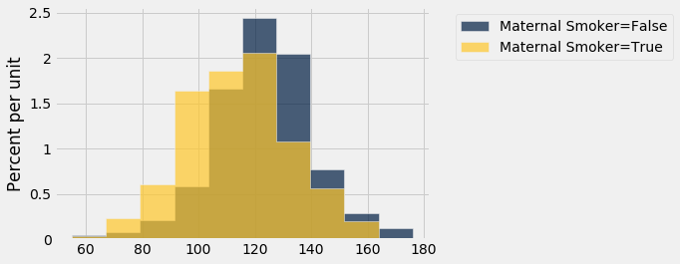
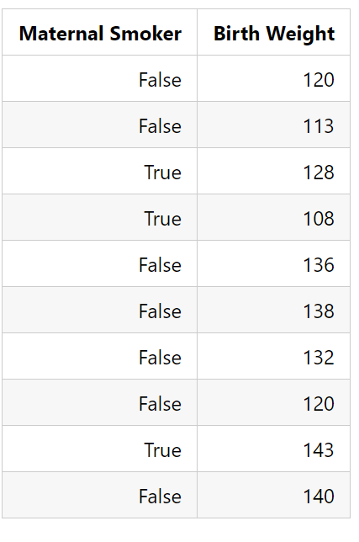
A/B Testing
A special hypothesis test to determine whether two samples come from the same underlying distribution.
If the 2 come from the same underlying distribution, then the labels don't matter. Shuffle them to simulate the null hypothesis
Shuffle a column by sampling a table without replacement
Remember that shuffling the values column instead would achieve the same outcome

Slide 42
A/B Testing & Hypothesis Testing
Similarities
Both include a null hypothesis and an alternative hypothesis.
For a set number of repetitions, both processes involve:
Drawing a sample and calculating a test statistic.
Features specific to A/B testing:
Test statistic is often (but not always) the difference or absolute difference between group means
Difference if alternative hypothesis has a direction
Absolute difference if alternative hypothesis test does not have a direction
Null hypothesis is simulated by shuffling the labels column of the table

Slide 43
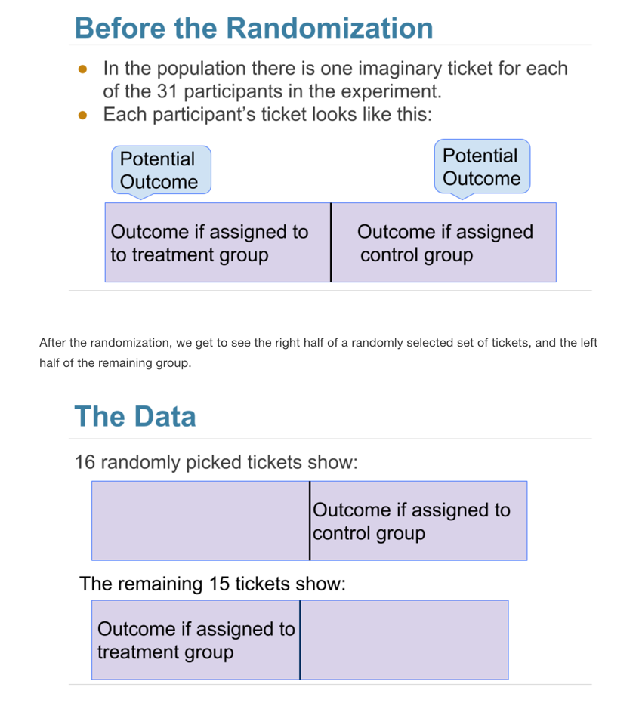
A/B Testing and Causality
Use A/B test to determine whether the treatment causes the outcome in a randomized controlled experiment
Do the treatment and control groups come from the same underlying distribution?

Slide 44
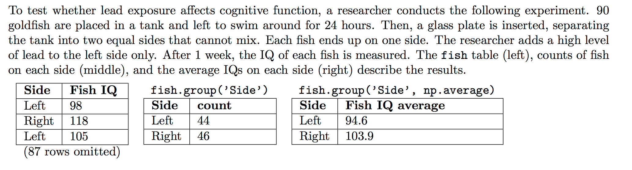
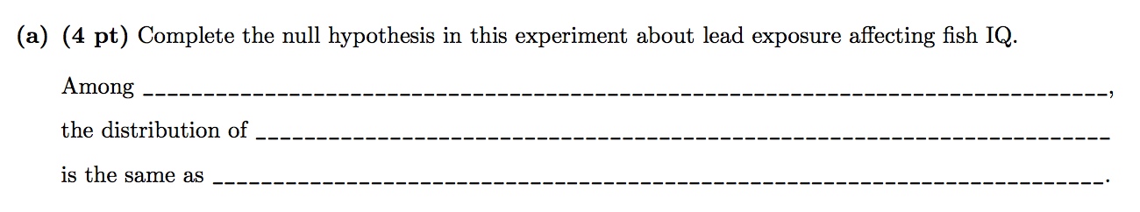
Practice Problem

Slide 45
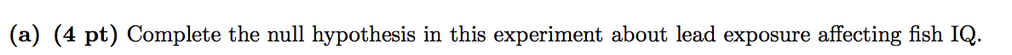
Spring 2016 A/B Testing Solutions
Among the fish in the experiment,
the distribution of IQ scores of the fish exposed to lead
is the same as the distribution of IQ scores of fish not exposed to lead. Any variation is due to chance.

Slide 46
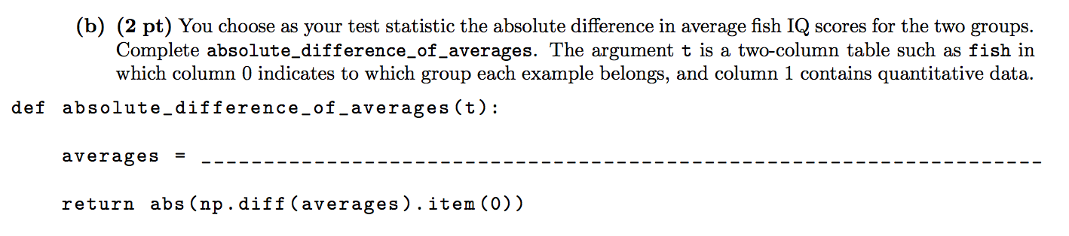
Spring 2016 A/B Testing Solutions

Slide 47
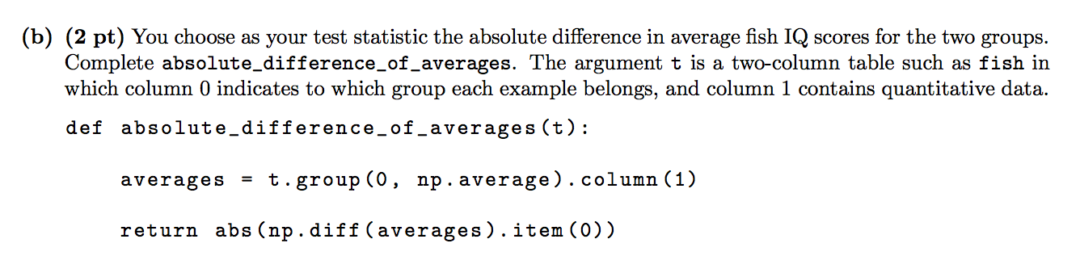
Spring 2016 A/B Testing Solutions

Slide 48
Spring 2016 A/B Testing Solutions

Slide 49
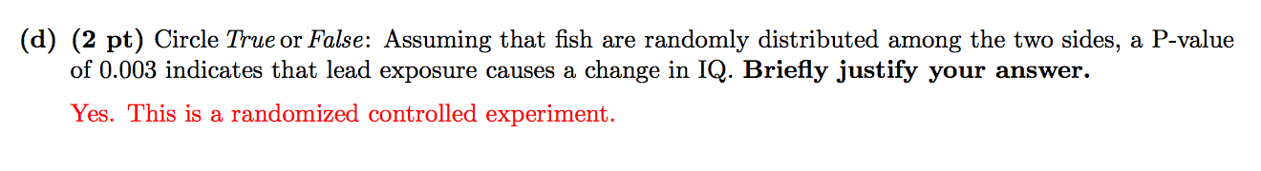
Spring 2016 A/B Testing Solutions

Slide 50
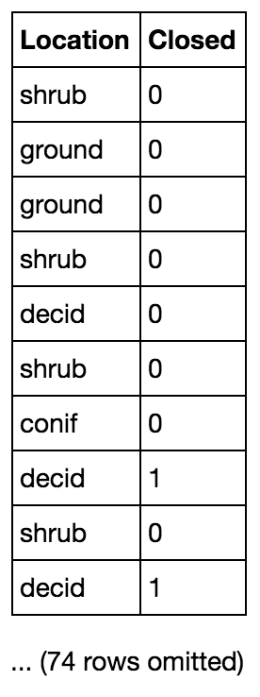
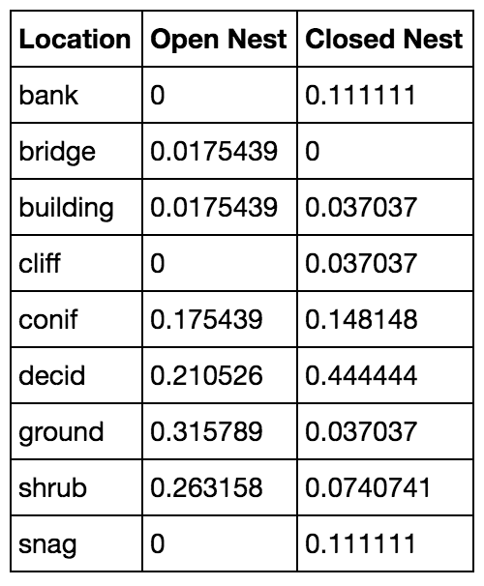
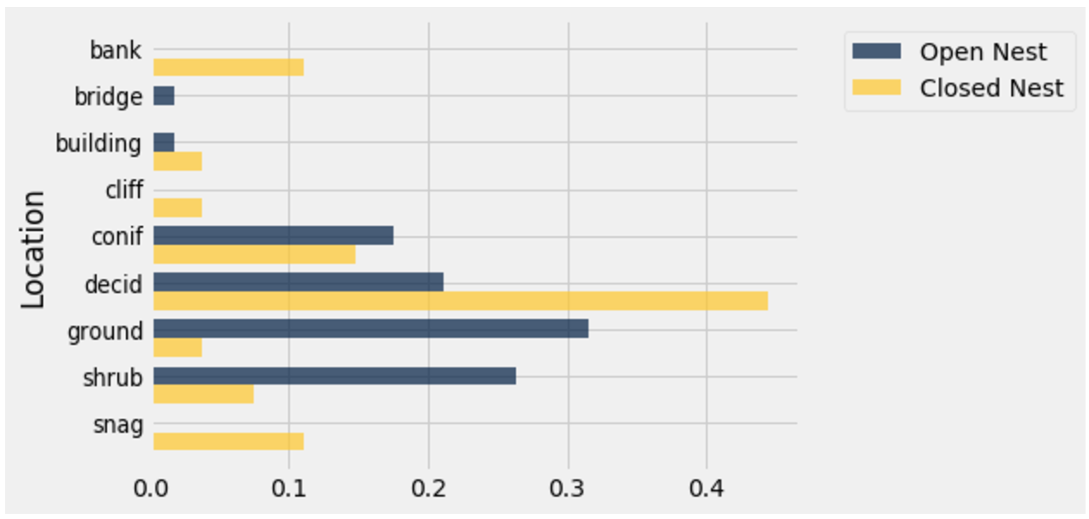
Bird Nests
birds
dists
Annie is a bird enthusiast and wants to determine whether the location of a bird’s nest is related to whether the nest is open or closed. She has gone around and collected data about birds’ nest locations and whether or not their nests are closed (1 = closed, 0 = open). She compiled all of the information into a table called birds. The first 10 rows of birds are shown below along with a bar graph and the table dists that contains the proportion of each type of nest in every location in the sample. Annie would like to know whether the distribution of locations of closed nests is similar to that of the distribution of locations of open nests.

Slide 51
Bird Nests
birds
dists
A. Write a null hypothesis for this test.

Slide 52
Bird Nests
birds
dists
A. Write a null hypothesis for this test.
In the population, the distributions of locations of closed nests and open nests are the same. Any variation in the sample is due to chance.

Slide 53
Bird Nests
birds
dists
B. Given that both variables are categorical,
what is a good test statistic for this analysis?
C. Write a function to compute this test statistic.
Assume that dist1 and dist2 are arrays.
def test_stat(dist1, dist2):
return ___________________________________

Slide 54
Bird Nests
birds
dists
B. Given that both variables are categorical,
what is a good test statistic for this analysis?
Total variation distance
C. Write a function to compute this test statistic.
Assume that dist1 and dist2 are arrays.
def test_stat(dist1, dist2):
return ___________________________________
0.5*(np.sum(np.abs(dist1 - dist2)))

Slide 55
Bird Nests
birds
dists
d. Complete the following code to use A/B testing and compute the P-value. Assume that you are given a function proportions that converts an array of counts to an array of proportions. For reference, the first 2 rows of birds and dists are shown above.
observed_stat = test_stat(________, _________)
stats = make_array()
reps = 10000
for i in np.arange(________):
shuffled_loc = birds.select("Location").sample(with_replacement=___).column(0)
shuffled = birds.drop(_______).with_column(“Shuffled Location”, ____________)
shuffled_counts = shuffled.pivot("Closed", _______________)
new_stat = _________(proportions(______________), proportions(____________))
_________ = np.append(stats, ____________)
emp_p = ______________________________________

Slide 56
Bird Nests Solutions
d. Complete the following code to use A/B testing and compute the P-value. Assume that you are given a function proportions that converts an array of counts to an array of proportions. For reference, the first 2 rows of birds and dists are shown above.
observed_stat = test_stat(dists.column(1), dists.column(2))
stats = make_array()
reps = 10000
for i in np.arange(reps):
shuffled_loc =birds.select("Location").sample(with_replacement=False).column(0)
shuffled =birds.drop("Location").with_column(“Shuffled Location”, shuffled_loc)
shuffled_counts = shuffled.pivot("Closed", “Shuffled Location”)
new_stat = test_stat(proportions(shuffled_counts.column(1),
proportions(shuffled_counts.column(2)))
stats = np.append(stats, new_stat)
emp_p = np.count_nonzero(stats >= observed_stat)/reps

Slide 57

Additional Questions:
For the following questions, please state whether or not you would use A/B Testing with the following problems (T/F):
Berkeley and Stanford students’ grades come from the same underlying distribution.
The proportion of Data 8 students who take 61A the following semester vs those who take CS 88 the following semester come from the same underlying distribution.
Notes:
Mean of binary variable is proportion

Slide 58
Additional Questions:
For the following questions, please state whether or not you would use A/B Testing with the following problems (T/F):
Berkeley and Stanford students’ grades come from the same underlying distribution. True (but do they really?)
The proportion of Data 8 students who take 61A the following semester vs those who take CS 88 the following semester come from the same underlying distribution. True
Notes:
Mean of binary variable is proportion

Slide 59
Additional Questions:
3. Throughout dead week, you’ve visited Moffitt, Main Stacks, Kresge, and MLK to study and you suspect that more lowerclassmen visit Moffitt and more upperclassmen visit Kresge. You want to test if there is a difference in the frequency of library visits to Moffitt, Main Stacks, Kresge, and MLK between lower and upperclassmen.
4. The number of students who attend Data8 OH is the same on the each day of the week (M-F).

Slide 60
Additional Questions:
3. Throughout dead week, you’ve visited Moffitt, Main Stacks, Kresge, and MLK to study and you suspect that more lowerclassmen visit Moffitt and more upperclassmen visit Kresge. You want to test if there is a difference in the frequency of library visits to Moffitt, Main Stacks, Kresge, and MLK between lower and upperclassmen. True
4. The number of students who attend Data8 OH is the same on the each day of the week (M-F). False

Slide 61
Questions?

